Slide 1


Enhancement (CO2)
Image enhancement refers to the process of highlighting certain information of an image, as well as weakening or removing any unnecessary information according to specific needs.
For example, eliminating noise, revealing blurred details, and adjusting levels to highlight features of an image.
Image enhancement techniques can be divided into two broad categories:
Spatial domain — enhancement the image space that divides an image into uniform pixels according to the spatial coordinates with a certain resolution. The spatial domain methods perform operations on pixels directly
Frequency domain — enhancement obtained by applying the Fourier Transform to the spatial domain. In the frequency domain, pixels are operated in groups as well as indirectly.

Slide 2
Spatial Domain Method
A indicated previously, the term spatial domain refers to the aggregate of pixels composing an image.
Spatial Domain methods are procedures that operate directly on these pixels.
Spatial domain processes will be denoted by the expression:
The concept is to map every pixel onto a new image with a predefined transformation function.
g(x, y) = T(f(x, y))
g (x, y) is the output image
T is an operator that can operate on a set of input
f (x, y) is the input image.

Slide 3
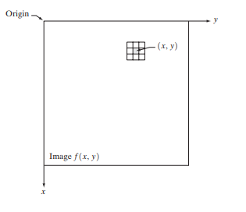
Transformation(T)
The simplest of T, is when the neighborhood of size 1X1 (that is a form single pixel).
In this case, g depends only on the value of f at (x,y).and T becomes a grey-level (also called intensity or mapping) transformation function of the form:
S = T (r)
Where, for simplicity in notation, r and s are variables denoting, respectively, the grey level of f(x,y) and g(x,y) at any point (x,y)

Slide 4
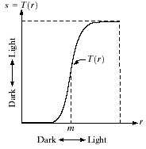
Contrast Stretching (CO2)
Contrast Stretching:
If T(r) has the form as shown in the figure below, the effect of applying the transformation to every pixel of f to generate the corresponding pixels in g would:
Produce higher contrast than the original image, by:
Darkening the levels below m in the original image
Brightening the levels above m in the original image.

Slide 5
Contd…
So. Contrast Stretching is a simple image enhancement technique that improves the contrast in an image by 'stretching’ the range of intensity values it contains to span a desired range of values. Typically, it uses a linear function.

Slide 6

Histogram Specification (CO2)
Histogram Equalization is an automated technique to improve the contrast of the image.
Histogram equalization does not require any parameters or thresholds.
The only information it makes use of is the histogram of the input image.
The basic idea behind histogram equalization is to produce an output image with a constant histogram.
The probability density function of the pixel intensities in the output image is 1.
All intensity values (gray shades) get an equal representation in the image.

Slide 7
Contd…
We use the following notation:
g | variable representing the intensities in the given input image.
e | variable representing the intensities in the output image which would have an equalized histogram
pg | represents the probability density function of the pixel intensities g in the given image.
pe | represents the probability density function of the pixel intensities e in the output image
H | represents a histogram based mapping function from input intensities g to output intensities e. i.e.
7

Slide 8
Overview of the histogram specification process
Compute the cumulative distribution function (CDF): Calculate the CDF of the input image's histogram. The CDF represents the accumulated probability of each intensity value in the image.
Compute the desired cumulative distribution function (CDF): Calculate the CDF of the desired histogram or the target image's histogram. The desired CDF represents the desired distribution of intensity values.
Compute the mapping function: Establish a mapping function between the input image's CDF and the desired CDF. This mapping function transforms the intensities of the input image to match the desired histogram.
8

Slide 9
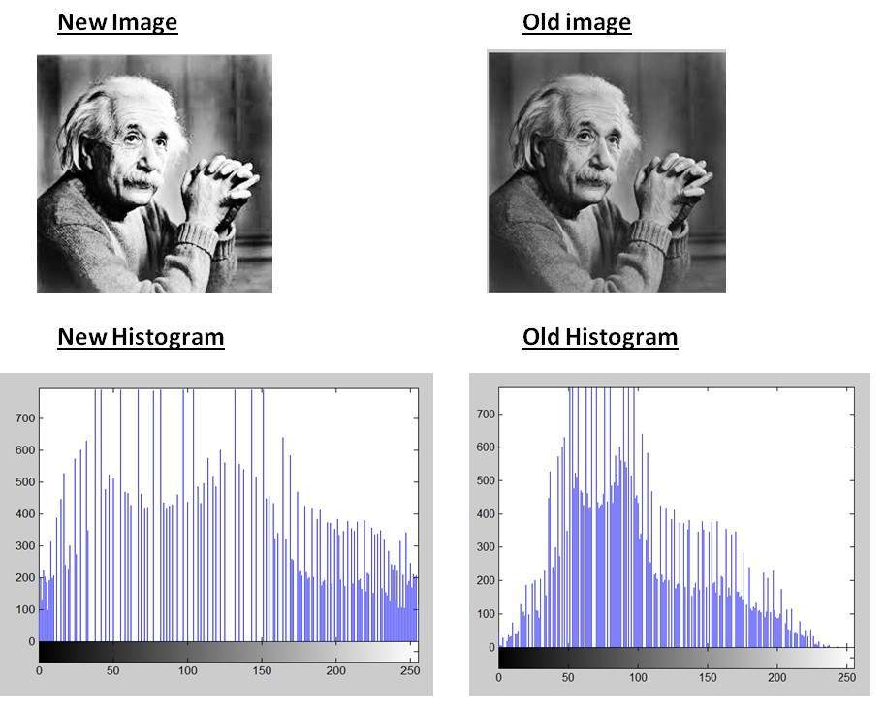
Contd…
Apply the mapping function: Apply the mapping function to each pixel in the input image. This function assigns new intensity values to each pixel based on the desired histogram.
Adjust intensity values: If necessary, clip or scale the intensity values to ensure they fall within the valid range (e.g., 0-255 for an 8-bit image).
Example of histogram specification:
9

Slide 10
Local Contrast Enhancement (CO2)
Local contrast enhancement, also known as local contrast adjustment or local histogram equalization, is a technique used to enhance the contrast and details in specific regions of an image.
Unlike global contrast enhancement techniques, which operate on the entire image, local contrast enhancement focuses on local neighborhoods or regions within the image.
Local contrast enhancement techniques are particularly useful in scenarios where different regions of an image have varying levels of contrast or lighting conditions.
By enhancing the contrast locally, details in both dark and bright regions can be preserved or brought out more effectively.

Slide 11
Contd…
Divide the image into overlapping regions: Split the image into smaller regions or tiles. The size of the regions depends on the characteristics of the image and the desired level of detail enhancement.
Calculate the histogram of each region: Compute the histogram for each region. The histogram represents the distribution of pixel intensities within a given region.
Perform contrast enhancement on each region: Apply a contrast enhancement technique, such as histogram equalization or adaptive histogram equalization (AHE), to each region individually. This step adjusts the pixel intensities within each region to improve local contrast.
Combine the enhanced regions: Reassemble the enhanced regions back into a complete image. Overlapping regions are merged or blended together to create a seamless transition between the enhanced regions.

Slide 12
Smoothing (CO2)
Smoothing Spatial Filter: Smoothing filter is used for blurring and noise reduction in the image. Blurring is pre-processing steps for removal of small details and Noise Reduction is accomplished by blurring.
Types of Smoothing Spatial Filter:
Linear Filter (Mean Filter)
Order Statistics (Non-linear) filter

Slide 13
Mean Filter (CO2)
Linear spatial filter is simply the average of the pixels contained in the neighborhood of the filter mask. The idea is replacing the value of every pixel in an image by the average of the grey levels in the neighborhood define by the filter mask.
Types of Mean filter:
(i) Averaging filter: It is used in reduction of the detail in image. All coefficients are equal.
(ii) Weighted averaging filter: In this, pixels are multiplied by different coefficients. Center pixel is multiplied by a higher value than average filter.

Slide 14
Order Statistics Filter (CO2)
It is based on the ordering the pixels contained in the image area encompassed by the filter. It replaces the value of the center pixel with the value determined by the ranking result. Edges are better preserved in this filtering.
Types of Order statistics filter:
(i) Minimum filter: 0th percentile filter is the minimum filter. The value of the center is replaced by the smallest value in the window.
(ii) Maximum filter: 100th percentile filter is the maximum filter. The value of the center is replaced by the largest value in the window.
(iii) Median filter: Each pixel in the image is considered. First neighboring pixels are sorted and original values of the pixel is replaced by the median of the list.

Slide 15
Sharpening (CO2)
Sharpening refers to the process of enhancing the clarity and definition of an image or object.
It is commonly used in photography, image editing, and graphics design to improve the sharpness and crispness of an image.
When an image is captured or processed, it may lose some sharpness due to various factors such as camera limitations, image compression, or blurring caused by motion or focus issues.
Sharpening techniques aim to counteract these effects and make the image appear clearer and more defined.
15

Slide 16
Sharpening (CO2)
When sharpening an image, it's important to strike a balance between enhancing details and avoiding the introduction of artifacts or noise.
Over-sharpening can lead to unnatural-looking results, halos around edges, or an increase in noise.
It's worth noting that sharpening cannot fully restore the quality of a severely blurred or out-of-focus image.
It is most effective when applied to images that have minor blurring or loss of sharpness.
Overall, sharpening is a valuable technique in image editing that can greatly improve the visual impact and clarity of photographs and digital images.

Slide 17
Common Sharpening Techniques
Unsharp Mask: This technique involves creating a blurred copy of the original image and subtracting it from the original to enhance edge contrast. It selectively sharpens edges while preserving smoother areas.
High Pass Filter: The high pass filter method accentuates the high-frequency details in an image by subtracting a blurred version of the image from the original. It enhances the edges and fine details, producing a sharpening effect.
Smart Sharpen: Smart Sharpen is a feature available in some advanced image editing software. It uses algorithms to analyze the image and selectively sharpen areas based on their content and structure, minimizing the introduction of noise and artifacts.
Sharpening Tools: Many image editing software offer dedicated sharpening tools with adjustable parameters such as radius, amount, and threshold. These tools allow users to manually control the sharpening effect to achieve the desired result.
17

Slide 18

Example of Sharpening

Slide 19
Spatial Convolution (CO2)
Spatial convolution is a fundamental operation in the field of computer vision and image processing.
It is a mathematical operation that involves applying a filter or kernel to an input image to produce an output image.
Convolutional neural networks (CNNs) extensively use spatial convolution as a building block for extracting features from images.
Spatial convolution has several important properties that make it useful in computer vision tasks. It enables the network to capture local patterns and structures in an image, such as edges, corners, or textures.
19

Slide 20
Contd…
By stacking multiple convolutional layers, CNNs can learn increasingly complex and abstract features.
Additionally, convolutional layers are typically followed by non-linear activation functions, such as ReLU, to introduce non-linearity into the network.
In spatial convolution, a small matrix called a kernel or filter is applied to each pixel of the input image. The kernel slides over the entire image, and at each position, the element-wise multiplication between the kernel and the corresponding pixels of the image is computed.
The resulting values are summed up to produce a single value, which becomes the corresponding pixel in the output image. This process is repeated for every pixel in the image, resulting in a transformed image.

Slide 21
Contd…
The size of the kernel determines the receptive field, which is the local region of the input image that affects the computation of a particular output pixel.
The values within the kernel are usually learned during the training process of a CNN, where they are optimized to extract meaningful features from the input image.
Overall, spatial convolution plays a crucial role in enabling CNNs to automatically learn and extract relevant features from images, making it a fundamental operation in modern computer vision applications.

Slide 22
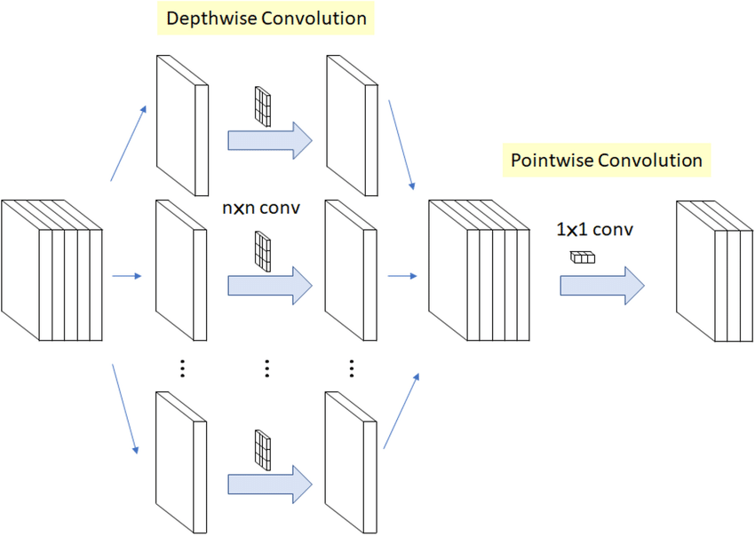
Example of spatial convolution

Slide 23
Gaussian Smoothing (CO2)
Gaussian smoothing, also known as Gaussian blur, is a technique used in image processing and signal processing to reduce noise and remove high-frequency detail from an image or signal.
It involves applying a Gaussian filter to the image or signal, which has the effect of averaging the values of neighboring pixels or samples.
The Gaussian filter is a convolutional filter that uses a Gaussian distribution as its kernel.
The Gaussian distribution is a bell-shaped curve that is characterized by its mean and standard deviation.
The standard deviation determines the width of the curve, which in turn affects the amount of smoothing applied to the image or signal.

Slide 24
Contd…
To apply Gaussian smoothing, the filter is convolved with the image or signal by sliding it over each pixel or sample and calculating the weighted average of the neighboring values.
The weights are determined by the values of the Gaussian distribution at each position within the filter.
The main advantage of Gaussian smoothing is its ability to reduce noise while preserving the overall structure and edges of the image or signal.
The Gaussian distribution has a natural blurring effect, which makes it suitable for smoothing applications.

Slide 25
Contd…
The Gaussian filter is separable, which means it can be applied in a more efficient manner by convolving the image or signal with a 1D filter in each dimension.
Gaussian smoothing is widely used in various applications, such as image denoising, image resizing, edge detection, and computer vision tasks.
It helps to remove noise and unwanted details while preserving important features, resulting in improved image quality or signal analysis.

Slide 26
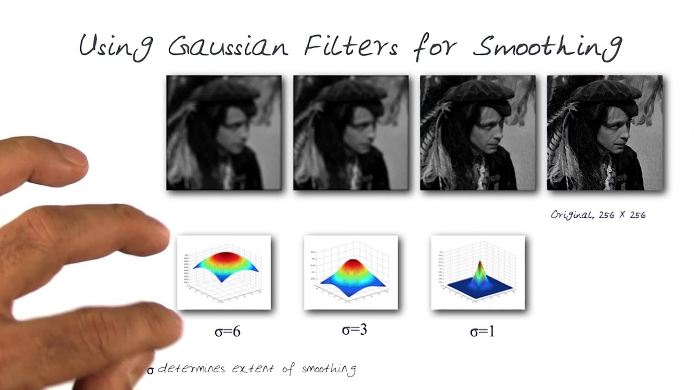
Example of Gaussian Smoothing

Slide 27
Difference of Gaussians (DoG) (CO2)
In image processing, DoG stands for "Difference of Gaussians." It is a technique used for feature detection and image enhancement.
The DoG method involves subtracting two Gaussian-blurred versions of an image to enhance edges and other significant features.
The DoG method is a fundamental technique in computer vision and has been widely used in various applications, such as image segmentation, object detection, and image analysis.
It provides a way to highlight image features by emphasizing changes in pixel intensities, making it useful for tasks that require edge detection or feature extraction.

Slide 28
Steps for applying DoG
Gaussian blurring: The original image is convolved with Gaussian filters of different scales. Gaussian filters are used to reduce noise and smooth the image. Multiple scales of Gaussian blurring are applied to capture features at different levels of detail.
Difference calculation: The blurred images obtained from different scales are subtracted from each other to obtain the DoG image. The purpose of this subtraction is to emphasize edges and other features present in the image.
Feature detection: The resulting DoG image is often used for feature detection. Local extrema (maxima and minima) in the DoG image are identified as potential key points or interest points in the original image. These points can then be used for tasks like object recognition, image matching, or image alignment

Slide 29
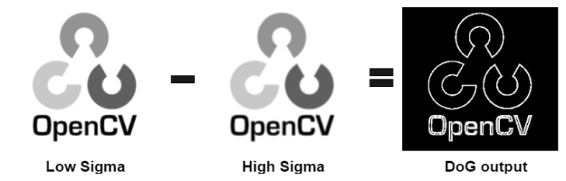
Example of DoG

Slide 30
Laplacian of Gaussian (LoG) (CO2)
In image processing, LoG stands for Laplacian of Gaussian.
It is a common technique used for edge detection and image enhancement.
The Laplacian of Gaussian combines two mathematical operations: the Laplacian operator and the Gaussian blur.
The Laplacian operator is a second-order derivative operator that detects rapid changes in intensity, typically indicating the presence of edges or boundaries in an image.
The Gaussian blur is a smoothing filter that reduces noise and removes fine details from an image.

Slide 31
Contd…
The Laplacian of Gaussian operator is often implemented as a convolution operation, where a kernel based on the desired scale and the properties of the Gaussian filter is applied to the image.
The LoG operator is widely used in computer vision, image analysis, and feature extraction tasks due to its ability to detect edges at different scales.
It can be employed for applications such as image segmentation, object recognition, and feature matching.

Slide 32
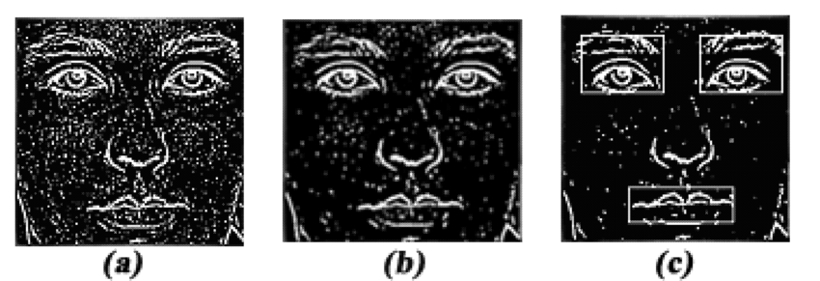
Example of Laplacian of Gaussian

Slide 33
Faculty Video Links, Youtube & NPTEL Video Links and Online Courses Details
https://www.youtube.com/watch?v=Y_-HgmvF9Zc
https://www.youtube.com/watch?v=MiSS_aEEf8w
https://www.youtube.com/watch?v=F3ZvWQMyj4I
https://www.youtube.com/watch?v=onWJQY5oFhs
https://www.youtube.com/watch?v=ecu8kreTwYM
https://www.youtube.com/watch?v=7ImSbCj8bRI
https://www.youtube.com/watch?v=yKFaHFwTg00

Slide 34
MCQ
1) What is the first and foremost step in Image Processing?
Image Restoration
Image Enhancement
Image Acquisition
Segmentation
G In which step of processing, the images are subdivided successively into smaller regions?
Image enhancement
Image acquisition
Segmentation
Wavelets

Slide 35
MCQ
3) Among the following image processing techniques which is fast, precise and flexible. a) Optical b) Digital c) Electronic d) Photographic
4) _____ is called matrix of each element…
a) pixels
b) value
c) coordinate
d) dots

Slide 36
MCQ
5) The origin of the digital image lies at a) Right bottom b) Top right corner c) Top left corner d) Left bottom
6) Low pass filters promotes
a) Low intensity Components
b) mid intensity Components
c) High intensity Components
d) All components

Slide 37
MCQ
7) Process involved in linear spatial filtering is a) correlation b) convolution c) histogram equalization d) Both A and B
8) Sum of all components in normalized histogram is equal to
a) 100
b) 2
c) 0
d) 1

Slide 38
Old Question Papers
Explain Fast Fourier Transform (FFT) in detail.
What are the linear and non-linear smoothing filters in spatial domain?
Explain edge detection and edge linking. Also write the difference between edge detection and edge linking.
What is image restoration? Explain in detail the image restoration in presence of noise only.
Difference between Spatial Domain and Frequency Domain.
Explain Homomorphic filtering.

Slide 39
Assignment
1. What do you mean by image Enhancement. Define its types in detail.
2. Explain Histogram specification in detail.
3. Explain smoothing and its types.
4. What is linear and order statistic filtering.
5. What do you mean by spatial convolution.
6. Explain DoG and LoG in detail/

Slide 40
Summary
Image processing is a method to perform some operations on an image, in order to get an enhanced image or to extract some useful information from it.
Image processing basically includes the following three steps:
Importing the image via image acquisition tools;
Analyzing and manipulating the image;
Output in which result can be altered image or report that is based on image analysis.

